Slide 1
HNDIT1012 Visual Application Programming
Week 2

Slide 2
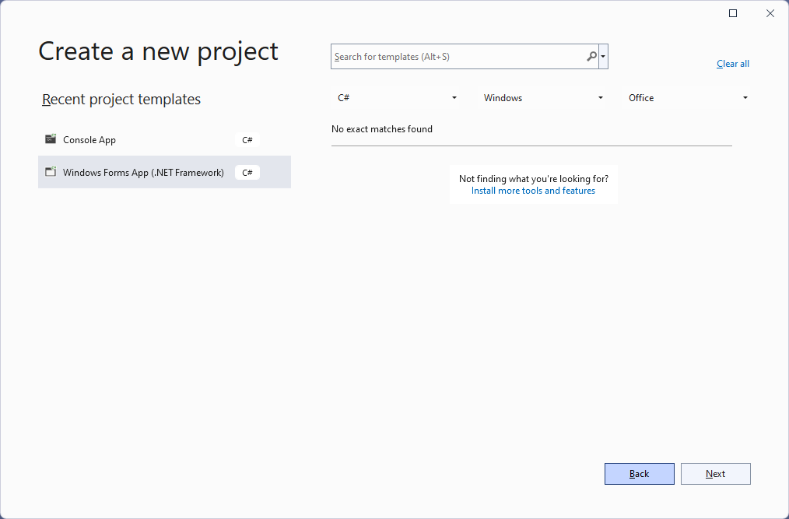
Windows Application - Step 1

Slide 3
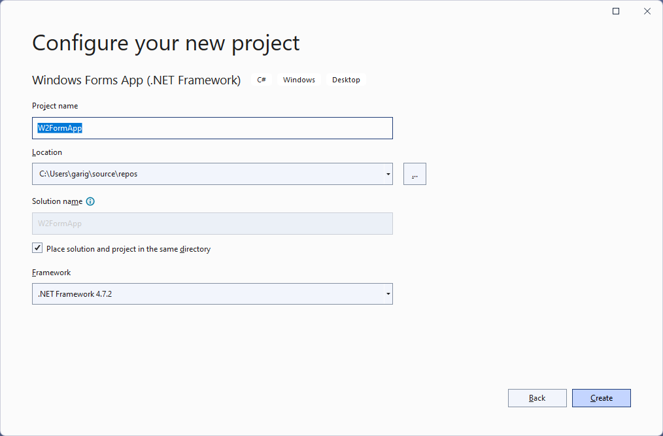
Step 2

Slide 4
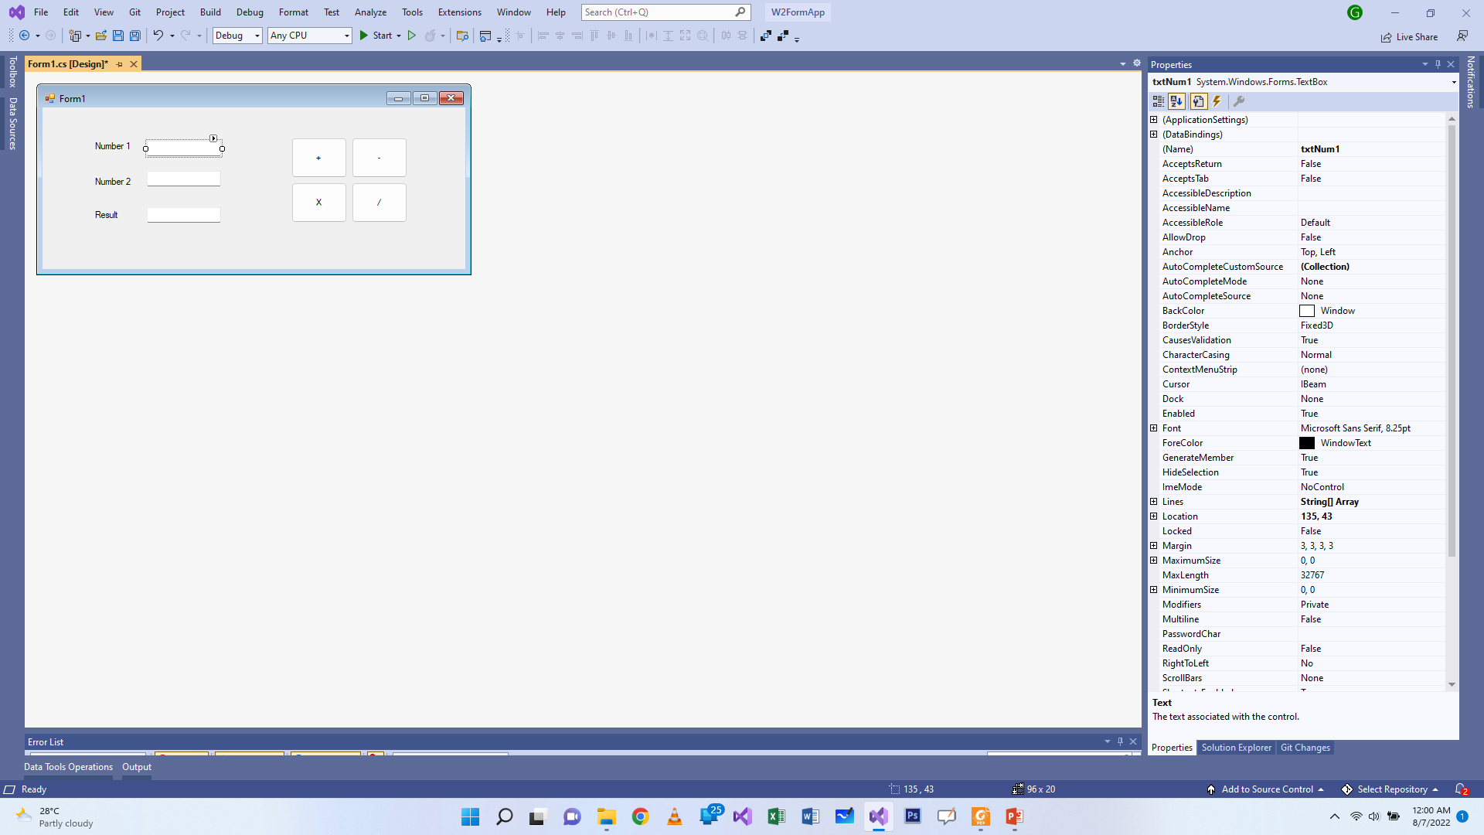
Designing Form – Step 3

Slide 5
Adding Controls
Design the form as shown above.
The controls used in the form are:
TextBox :Text box controls allow entering text on a form at runtime. By default, it takes a single line of text, however, you can make it accept multiple texts and even add scroll bars to it. Let's create a text box by dragging a Text Box control from the Toolbox and dropping it on the form.
Button : Button control is used to perform a click event in Windows Forms, and it can be clicked by a mouse or by pressing Enter keys.
Label : The Label control represents a standard Windows label. It is generally used to display some informative text on the GUI which is not changed during runtime.

Slide 6
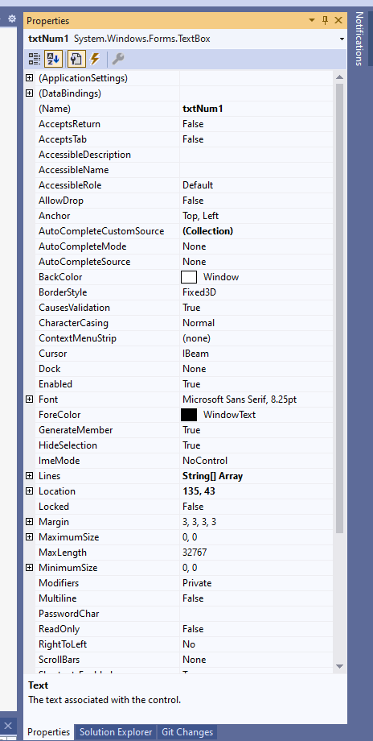
Property Window
You can find Properties Window on the View menu. You can also open it by pressing F4 or by typing Properties in the search box. The Properties window displays different types of editing fields, depending on the needs of a particular property.

Slide 7
Setting the properties – Step 4
Select the first textbox and set the name as txtNum1 on the property window.
Similarly set the names of other two textboxes as txtNum2 and txtResult respectively.
For Labels, Set the text property to Number 1, Number 2 and Result respectively
For Buttons, set the properties as shown in the given table.
Name | Text
btnPlus | +
btnMinus | -
btnMul | X
btnDiv | /

Slide 8
Events
An event is a signal that informs an application that something important has occurred.
For example, when a user clicks a control on a form, the form can raise a Click event and call a procedure that handles the event. Events also allow separate tasks to communicate.
Eg: click, double click, Key Press etc..

Slide 9
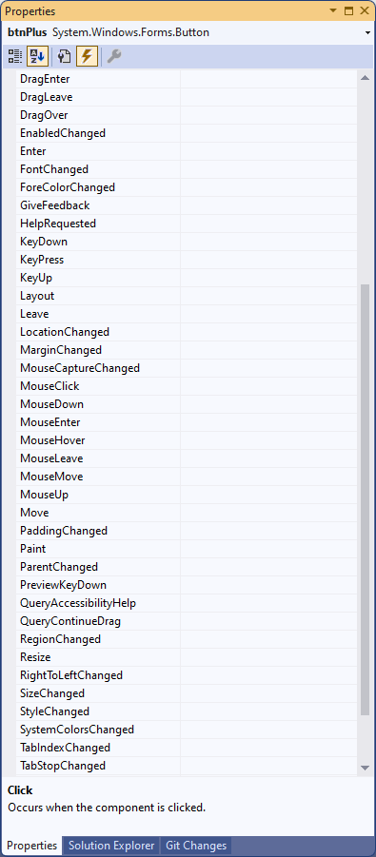
List of Events of a Button
Event Filter
You can filter List of events on property window by clicking the event filter

Slide 10
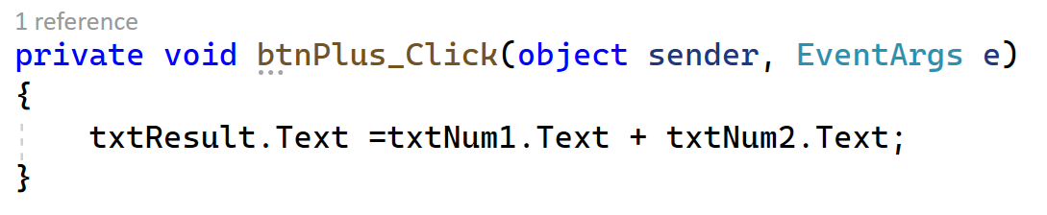
Adding Click events – Step 5
Double click on plus button to open code editor for click event and type the following code.

Slide 11
Running the application
Input values for Number1 and Number 2 and check the Result by clicking the plus button.
For eg:
Number 1 | Number 2 | Result
Com | puter | Computer
12 | 6 | 126
I am | Kumar | I amKumar

Slide 12
Addition Vs Concatenation
In the above example ‘+’ operator works as a string Concatenation operator, not an addition operator. Because both operands are string.
If you need addition operation, you have to convert both operands to numeric values such as integer, double etc..

Slide 13
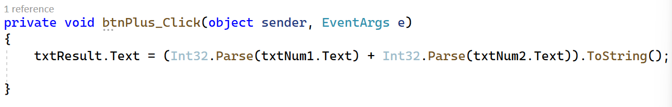
Change the code of the click event as shown below to do arithmetic operations like
+, -, * and /
Run the application and input integer values to Number 1 and Number 2

Slide 14
Int32.Parse Method
Converts the string representation of a number to its 32-bit signed integer equivalent.
toString Method
It converts an object to its string representation so that it is suitable for display.

Slide 15
C# Data types
C# type keyword | .NET type
bool | System.Boolean
byte | System.Byte
sbyte | System.SByte
char | System.Char
decimal | System.Decimal
double | System.Double
float | System.Single
int | System.Int32
uint | System.UInt32
nint | System.IntPtr
nuint | System.UIntPtr
long | System.Int64
ulong | System.UInt64
short | System.Int16
string | System.String

Slide 16
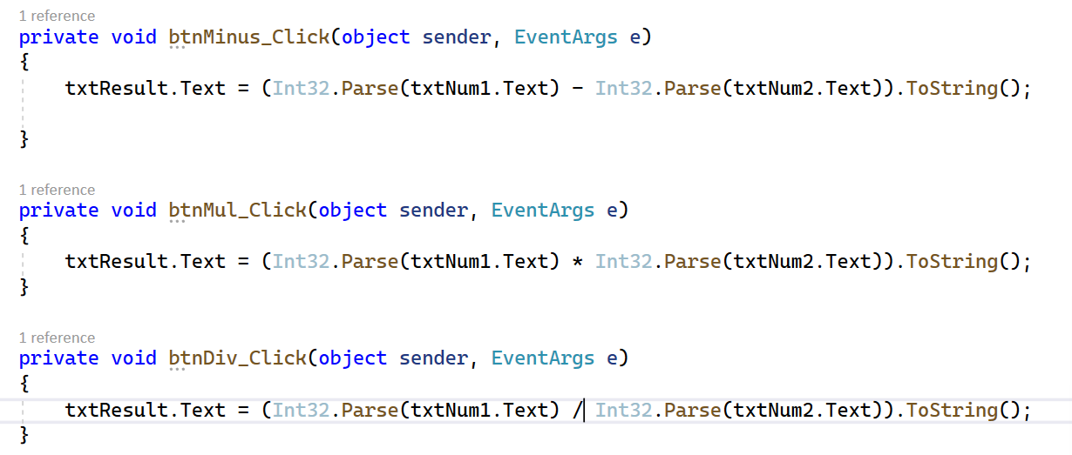
Add click events to other buttons and type the code as given below:

Slide 17
/ operator performs an integer division if both operands are integers.
Eg:
3/4 = 0
4/4 =1
5/4=1

Slide 18
C# Arithmetic Operators
Operator | Name | Description | Example
+ | Addition | Adds together two values | x + y
- | Subtraction | Subtracts one value from another | x - y
* | Multiplication | Multiplies two values | x * y
/ | Division | Divides one value by another | x / y
% | Modulus | Returns the division remainder | x % y
++ | Increment | Increases the value of a variable by 1 | x++
-- | Decrement | Decreases the value of a variable by 1 | x--

Slide 19
C# assignment Operators
Operator | Example | Same As
= | x = 5 | x = 5
+= | x += 3 | x = x + 3
-= | x -= 3 | x = x - 3
*= | x *= 3 | x = x * 3
/= | x /= 3 | x = x / 3
%= | x %= 3 | x = x % 3
&= | x &= 3 | x = x & 3
|= | x |= 3 | x = x | 3
^= | x ^= 3 | x = x ^ 3
>>= | x >>= 3 | x = x >> 3
<<= | x <<= 3 | x = x << 3

Slide 20
C# Comparison Operators
Operator | Name | Example
== | Equal to | x == y
!= | Not equal | x != y
> | Greater than | x > y
< | Less than | x < y
>= | Greater than or equal to | x >= y
<= | Less than or equal to | x <= y

Slide 21
C# Logical Operators
Operator | Name | Description | Example
&& | Logical and | Returns true if both statements are true | x < 5 && x < 10
|| | Logical or | Returns true if one of the statements is true | x < 5 || x < 4
! | Logical not | Reverse the result, returns false if the result is true | !(x < 5 && x < 10)

Slide 22
Bitwise Operators
Bitwise operator works on bits and perform bit by bit operation. The truth tables for
& - AND,
| - OR, and
^ - XOR are as follows −
p | q | p & q | p | q | p ^ q
0 | 0 | 0 | 0 | 0
0 | 1 | 0 | 1 | 1
1 | 1 | 1 | 1 | 0
1 | 0 | 0 | 1 | 1

Slide 23
Bitwise Operators
Assume if A = 60; and B = 13; then in the binary format they are as follows
A = 0011 1100 B = 0000 1101
Operator | Description | Example
& | Binary AND Operator copies a bit to the result if it exists in both operands. | (A & B) = 12, which is 0000 1100
| | Binary OR Operator copies a bit if it exists in either operand. | (A | B) = 61, which is 0011 1101
^ | Binary XOR Operator copies the bit if it is set in one operand but not both. | (A ^ B) = 49, which is 0011 0001
~ | Binary Ones Complement Operator is unary and has the effect of 'flipping' bits. | (~A ) = -61, which is 1100 0011 in 2's complement due to a signed binary number.
<< | Binary Left Shift Operator. The left operands value is moved left by the number of bits specified by the right operand. | A << 2 = 240, which is 1111 0000
>> | Binary Right Shift Operator. The left operands value is moved right by the number of bits specified by the right operand. | A >> 2 = 15, which is 0000 1111

Slide 24
Operator Precedence in C#
Category | Operator | Associativity
Postfix | () [] -> . ++ - - | Left to right
Unary | + - ! ~ ++ - - (type)* & sizeof | Right to left
Multiplicative | * / % | Left to right
Additive | + - | Left to right
Shift | << >> | Left to right
Relational | < <= > >= | Left to right
Equality | == != | Left to right
Bitwise AND | & | Left to right
Bitwise XOR | ^ | Left to right
Bitwise OR | | | Left to right
Logical AND | && | Left to right
Logical OR | || | Left to right
Conditional | ?: | Right to left
Assignment | = += -= *= /= %=>>= <<= &= ^= |= | Right to left
Comma | , | Left to right

Slide 25
Thank You

